Slide 1
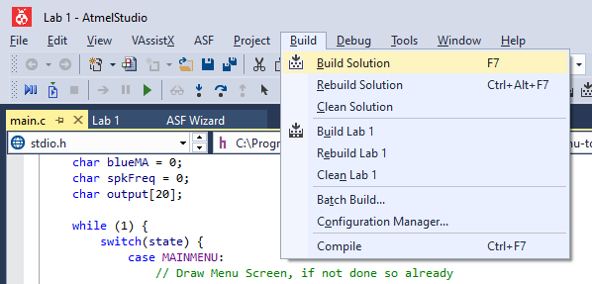
Checking your Code
Use the Build function (F7) in ATMEL studio to check for simple errors:
Syntax Errors
Undeclared Variables / Variables not in scope
Incorrect use of functions

Slide 2
Ways to check Inputs
By using Polling
  A protocol for how to check for inputs
  What you have been using up till now
  Requires constant checking (“polling”) of inputs
    A waste of CPU cycles, impacting performance
    Hinderance in Real Time Applications
By implementing Interrupts
  A hardware mechanism of the μC
  CPU only used when interrupts are triggered
  Allows for instantaneous actioning of data
  Interrupts any current instruction of your application
    Make sure you consider how your interrupt may impact application in run-time (hence, keep your interrupts short)
Notes:
Polling is like checking for new events on your phone manually (tedious, waste of time, only current in the instant).
Interrupts is like receiving notifications on your phone – but, not quite.

Slide 3
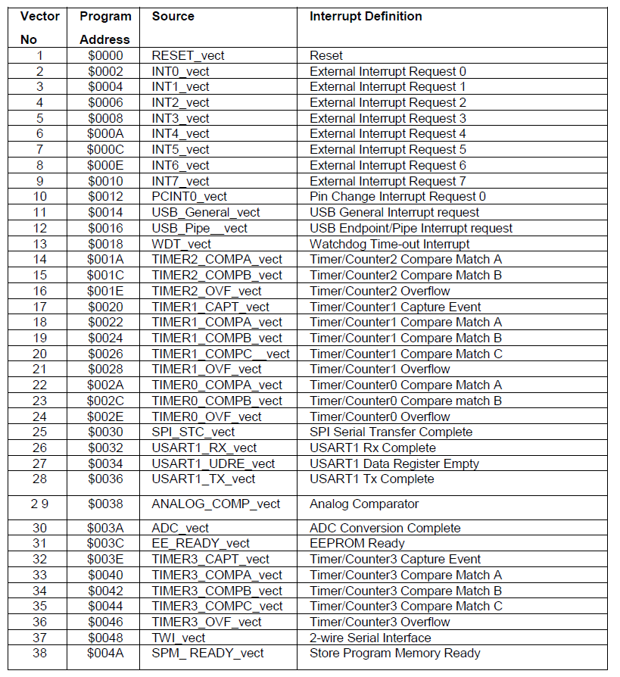
Interrupt Vectors Table
Use this table to identify the vectors you need to use:
Find the subsystem you need (ex. USART)
Find the trigger you want to use (ex. Rx Complete)
Ensure you enable the appropriate interrupt registers for the device (ex. RXCIE Flag in UCSR1B)
Notes:
Vector # and Program Address are not needed here. Focus on the “Source” you need based on the Interrupt Definition.

Slide 4
Using Interrupts in your Program
Include the <avr/interrupt.h> library
Create Interrupt Service Routines (ISRs) using the function ISR()
  Make sure you also declare the function definition
  Ensure that you pass in the name of the interrupt vector used
  Write the code inside the function that you want to use
Enable Interrupts using the sei() function, and setting the appropriate registers.
// Include the Interrupt Library
#include <avr/interrupt.h>
// Declare the Function Definition
for the ISR
ISR(Your Vector's Name);
// Write the code to run within
your interrupt
ISR(Your Vector's Name)
{
// Your Code Here
}
// Enable Interrupts in your
setup() function
sei();

Slide 5
Example: Receiving Data over USART
This code takes the 8-bit value received over the USART and displays on PORTC:
The example is the basic outline to show you how vectors can be used.
Use the USART1_RX_vect
Enable Interrupts in setup()
  Using the sei() function
Create Interrupt Service Routines (ISRs) using the function ISR()
  Stores the value from the USART
  Writes to PORTC
Ensure interrupts are enabled on the USART registers
  UCSR1B: RXCIE
ISR(USART1_RX_vect);
void setup(void);
int main (void)
{
setup();
}
// Every Time USART recieves data, show on PORTC
ISR(USART1_RX_vect)
{
char valueToDisplay = UDR1;
PORTC = valueToDisplay;
}
void setup(void)
{
DDRC = 0xFF;
UCSR1B = 0b10010000;
UCSR1C = 0b00000110;
UBRR1L = 8;
// Enable Interrupts in your setup() function
sei();
}

